Slide 1
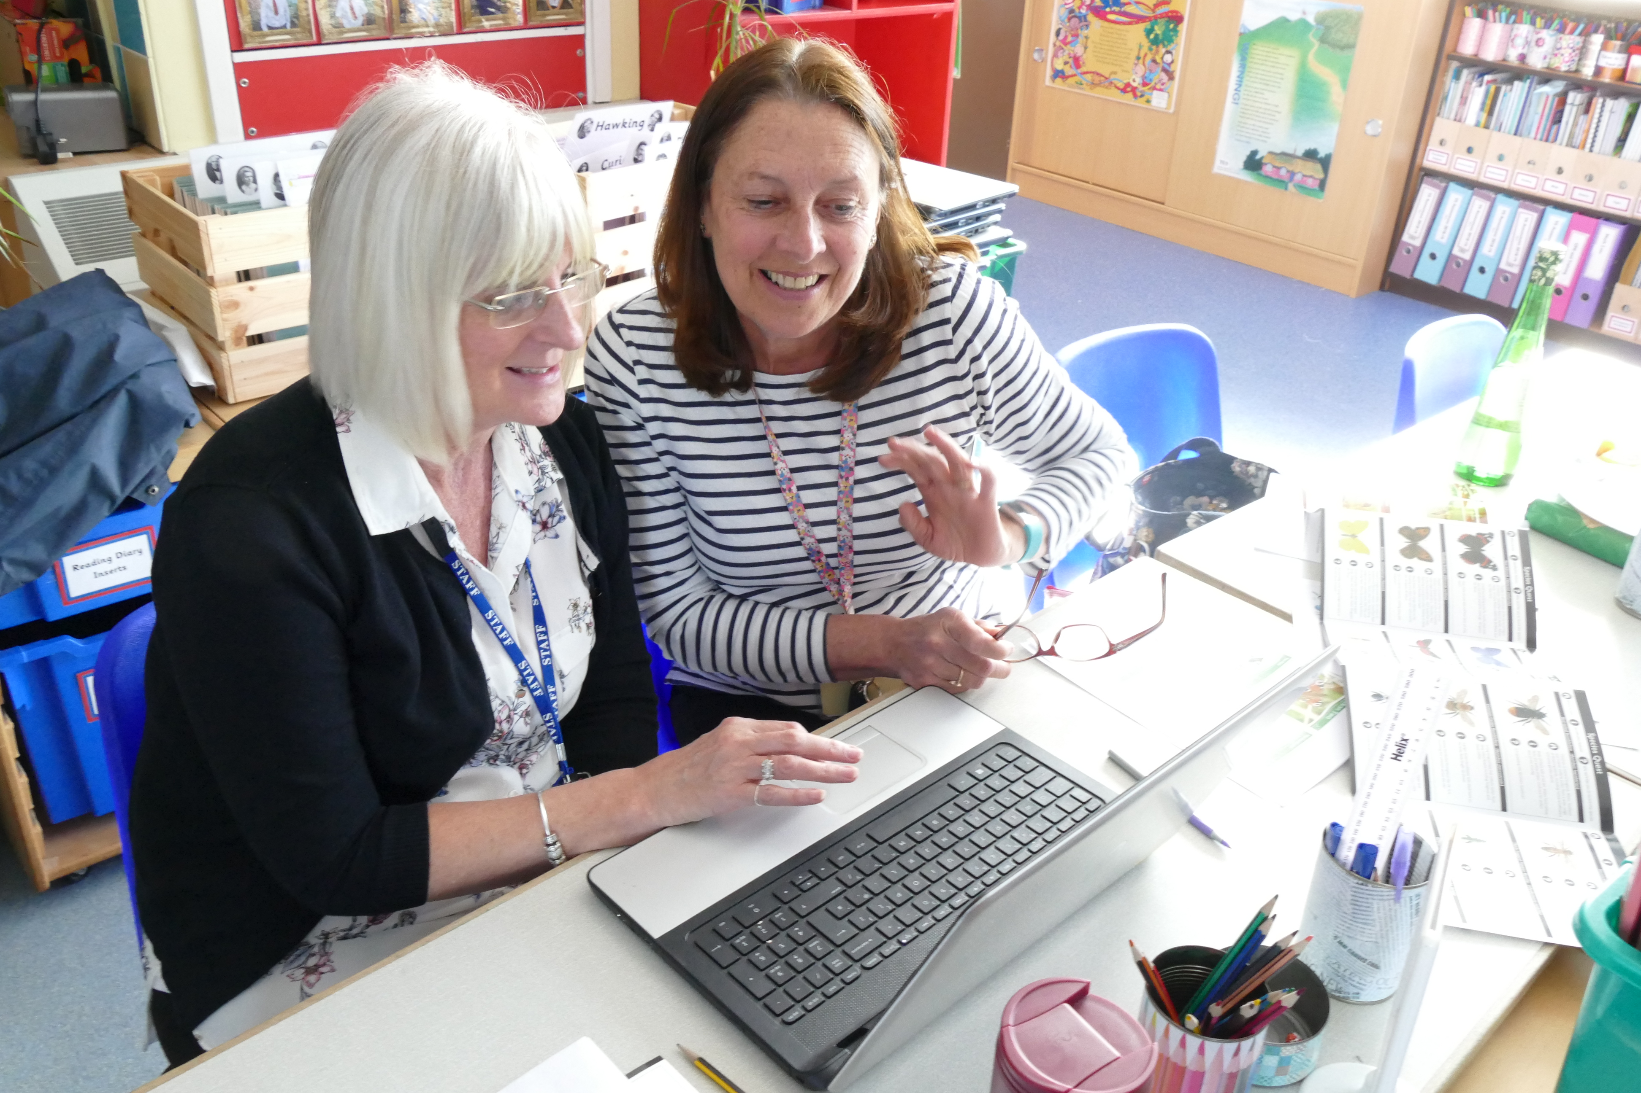
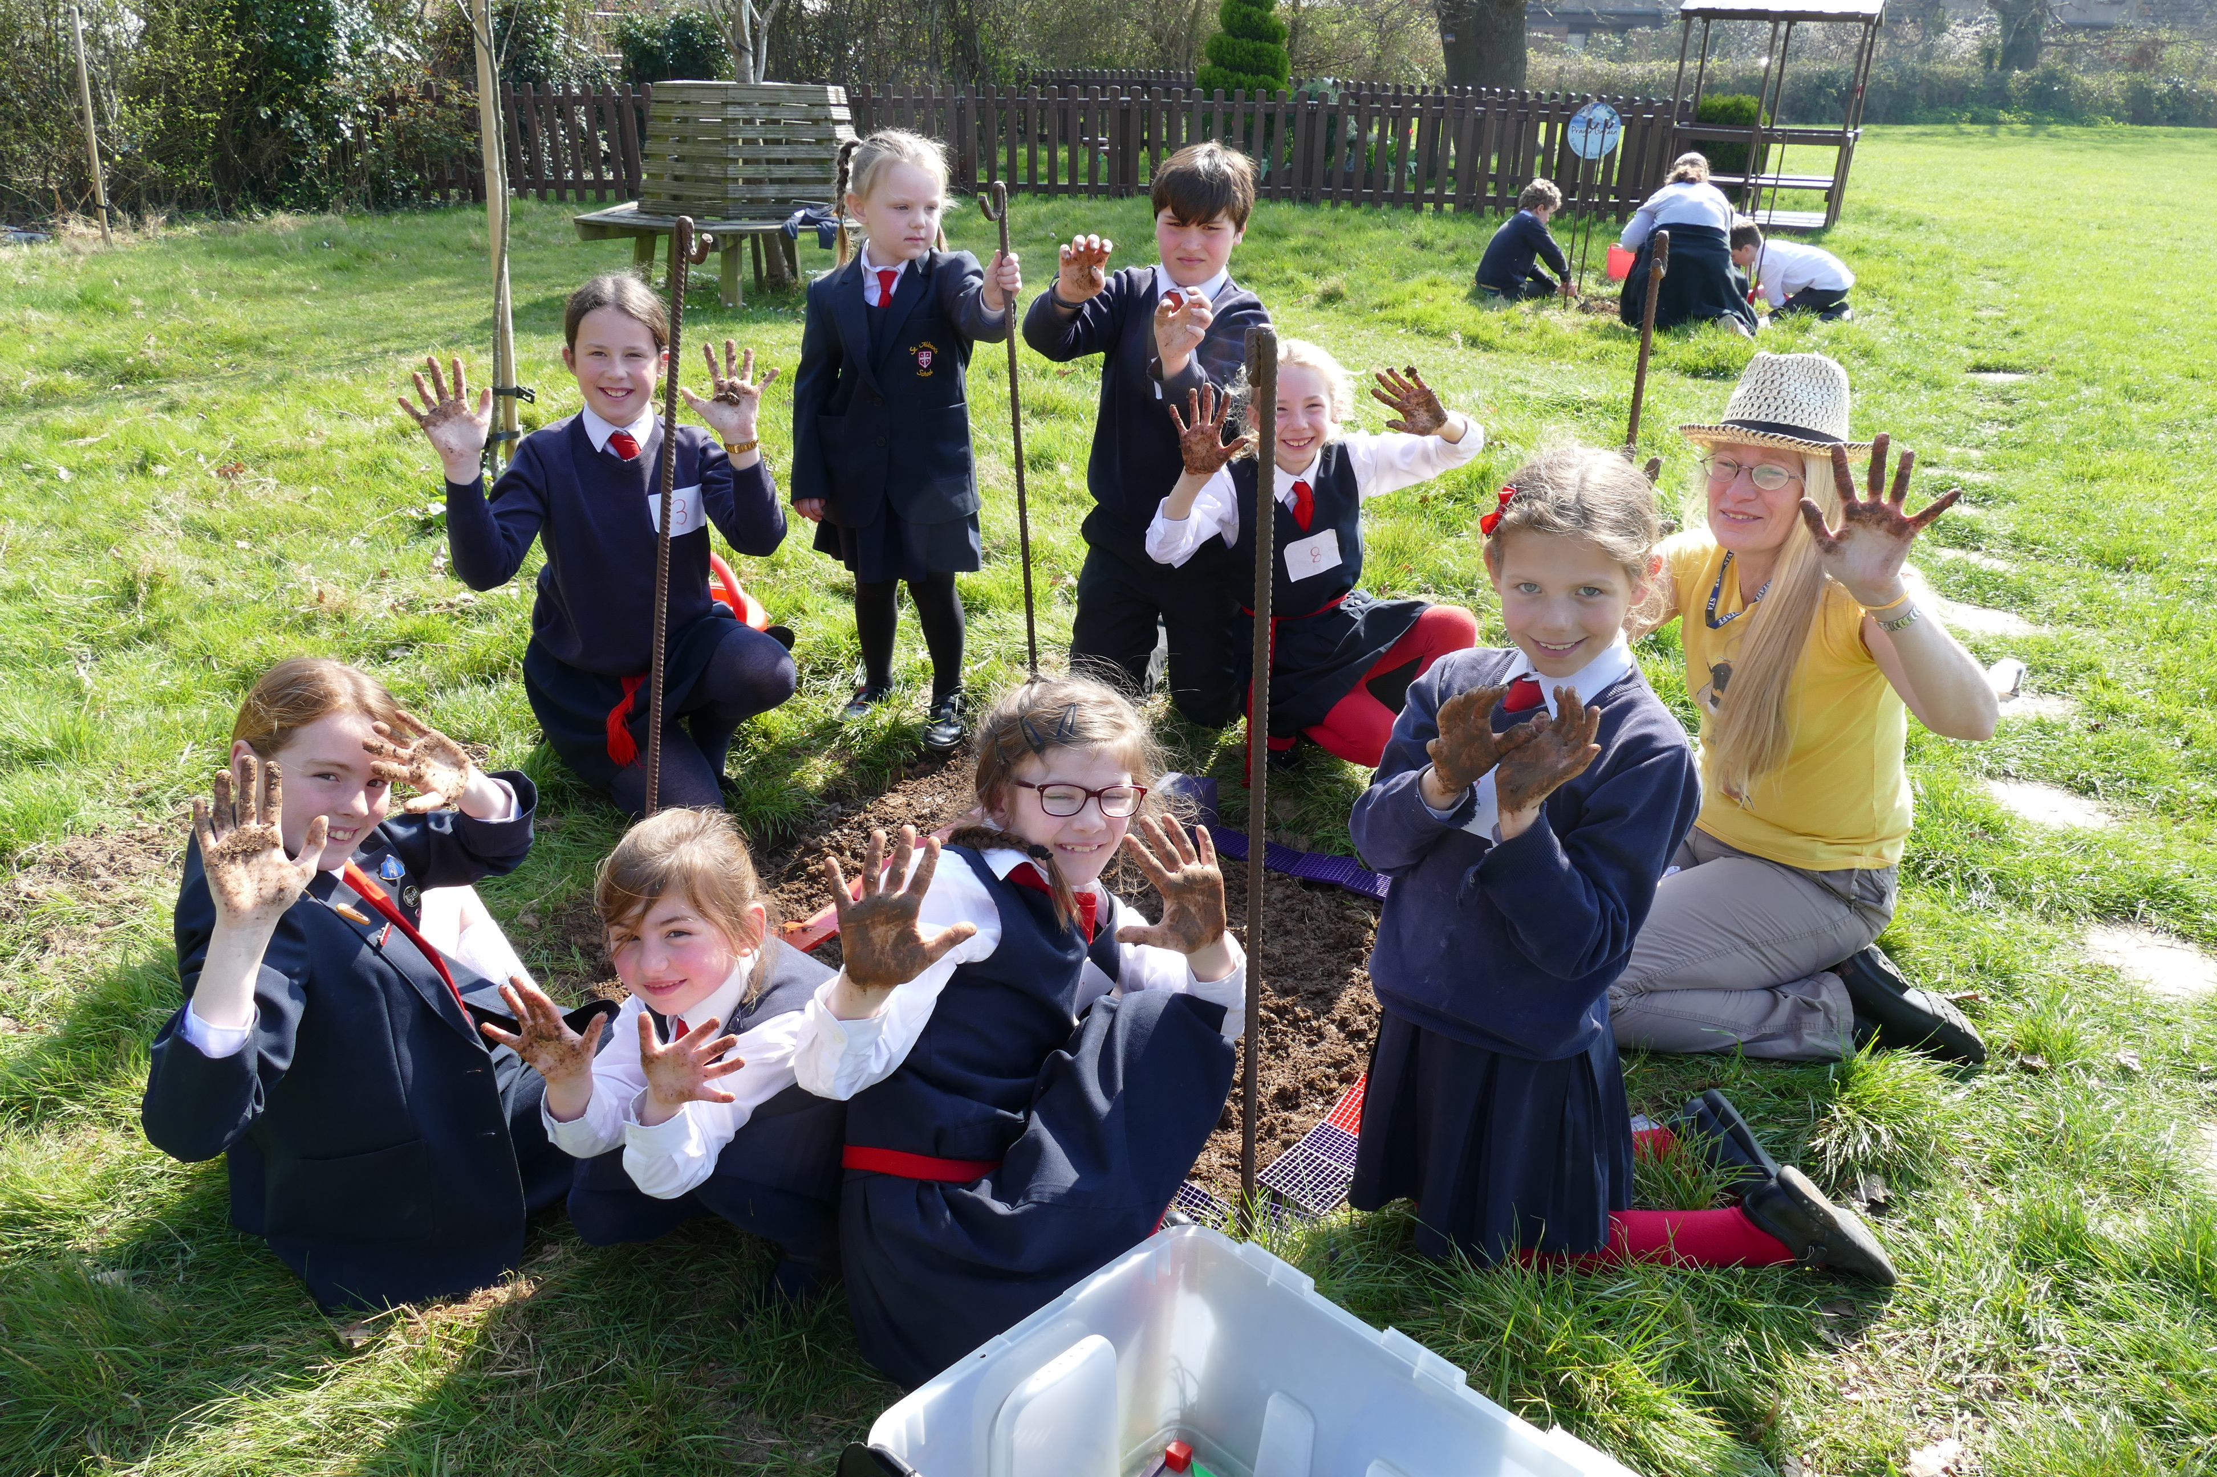
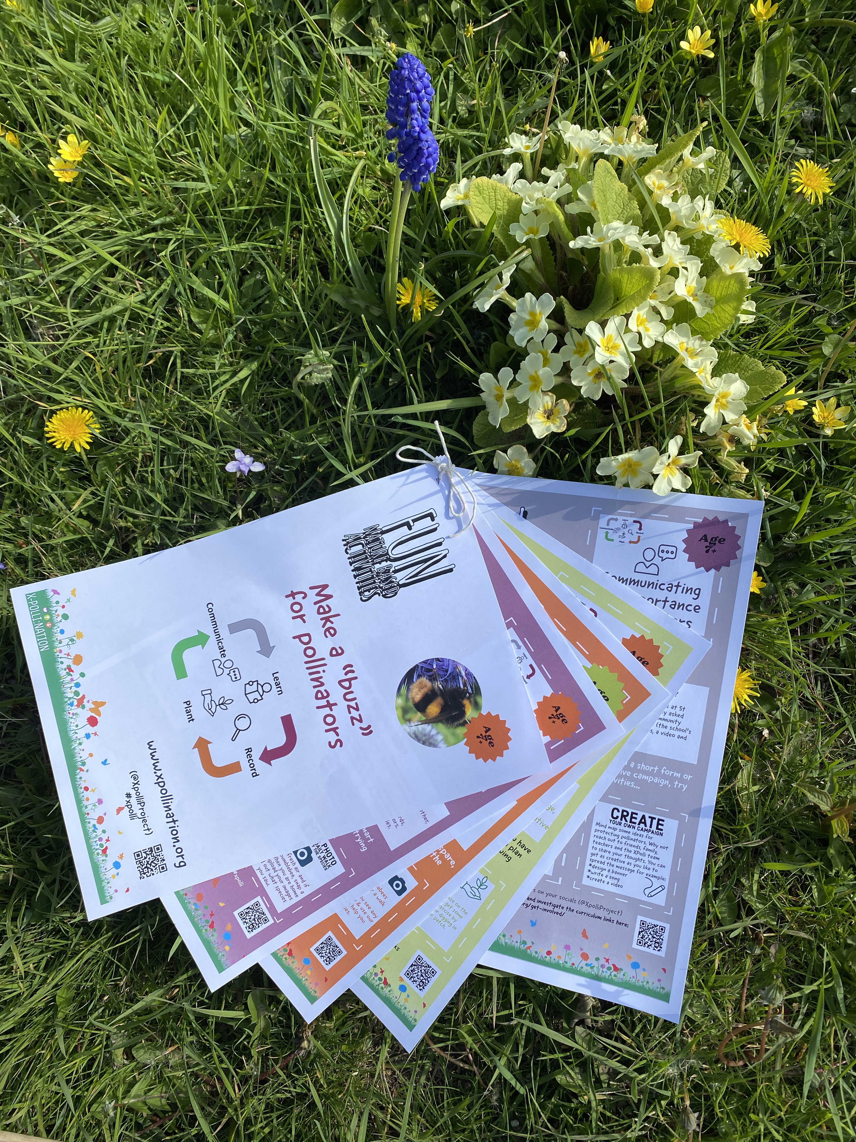
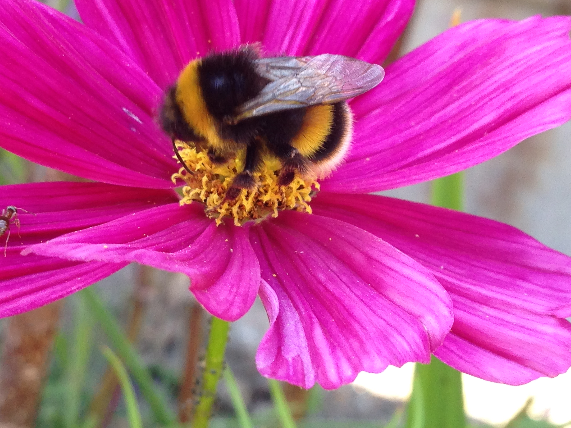
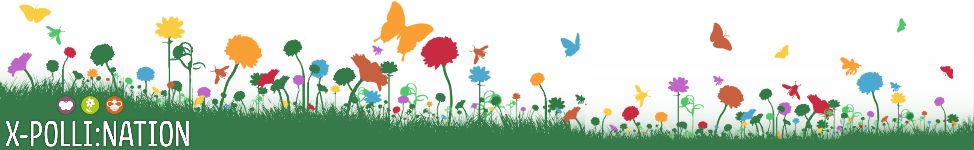
Pollination Citizen Science

Slide 2
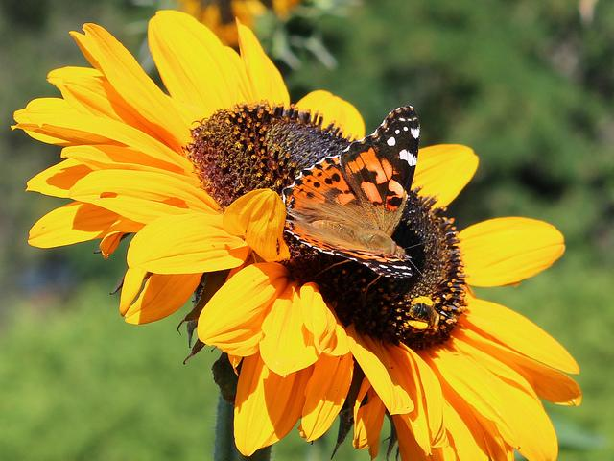
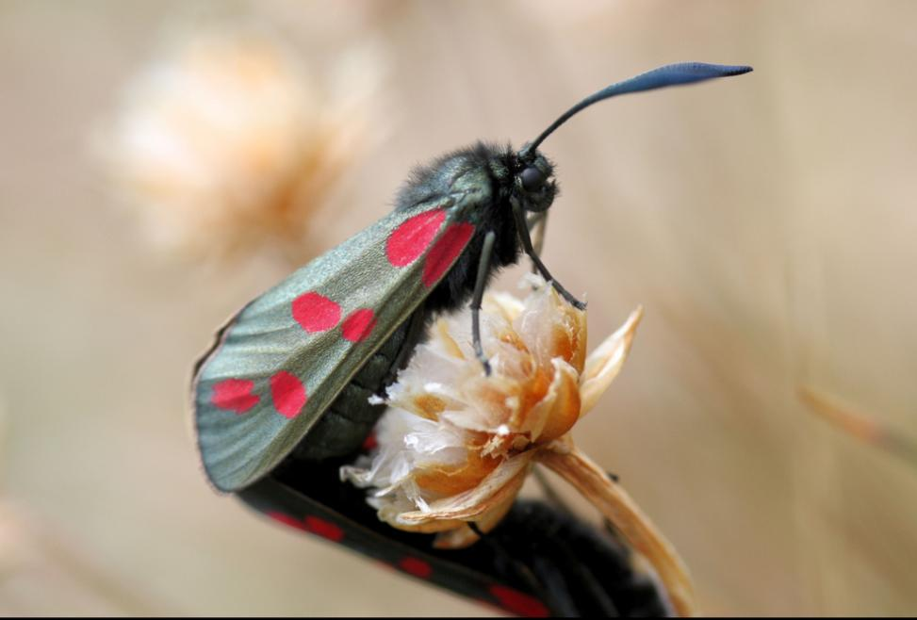
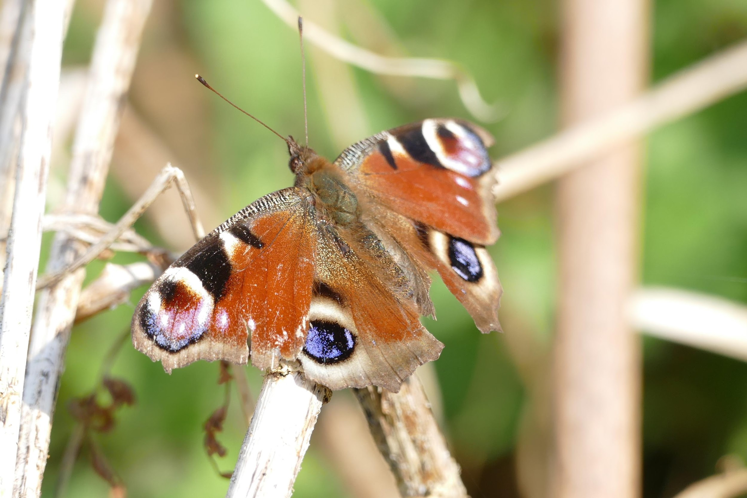
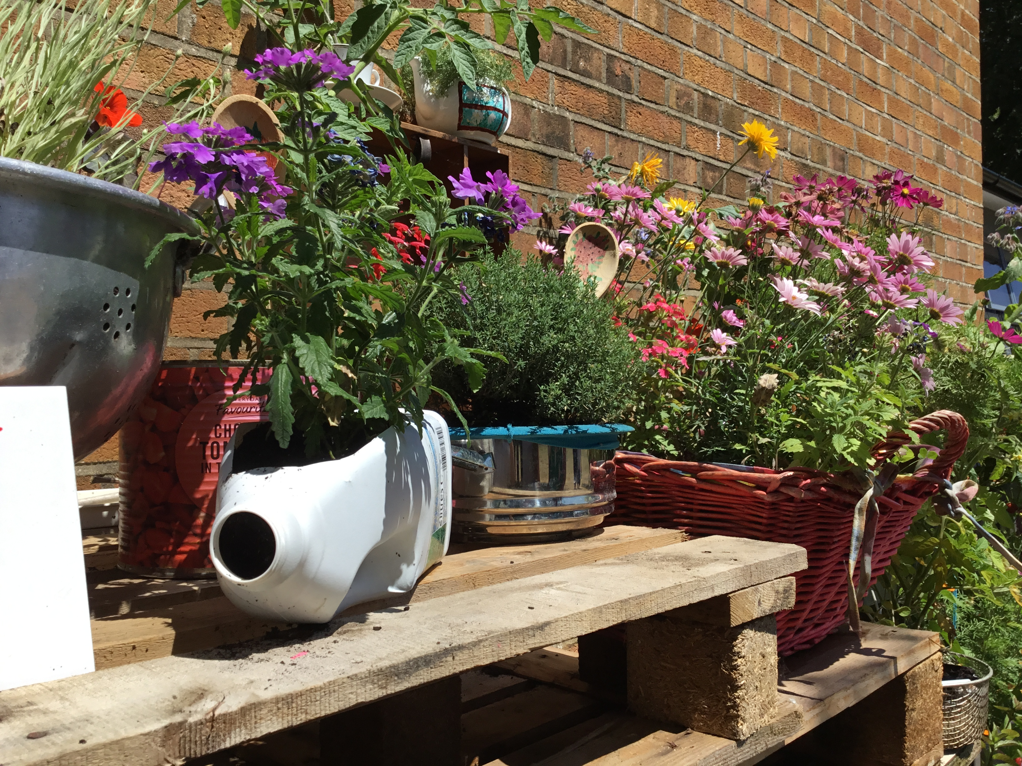
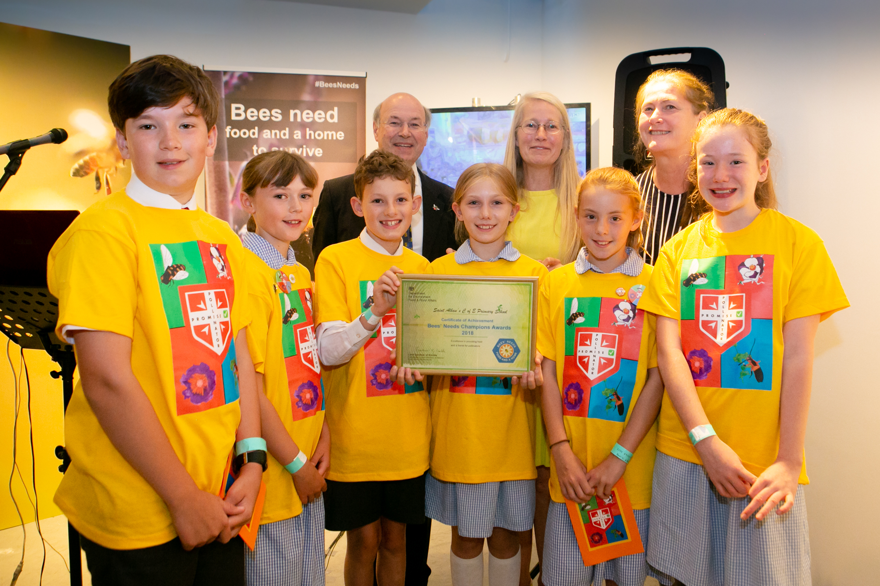
Overview
Introduction to the X-Polli:Nation Project
What is X-Polli:Nation, what’s involved and who can take part and resources for everyone and for group leaders
Learning about Pollinators
Resources for learning, why do we need pollinators, what are the threats, what do they need and how to identify the main pollinator groups?
Recording Pollinators
Citizen science survey of pollinator groups and photo records to help you identify bumblebee species
Planting for Pollinators
Online course to help you to make simple changes to your patch and an interactive planting for pollinators tool
Communicating the Importance of Pollinators
Making a Pollinator Promise and designing your own campaign for pollinators

Slide 3
Introduction
Painted lady (Vanessa cardui)

Slide 4




Aim: Engage and inspire young people to learn about and protect pollinators
Where: UK (Hampshire/Sussex) and Italy (Tuscany)
Drivers: ‘Cross-pollinating’ ideas about how to improve and expand pollination citizen science tools and approaches between technologists, academics, citizen science practitioners and school children.
Where to fund us: www.xpollination.org #XPolli #PolliPromise @XpolliProject
Who:
Funded by
Notes:
X-Polli:Nation aims to create a ‘buzz’ for pollinators by supporting:
‘people’ to learn and protect them, ‘
‘practice’ to improve citizen science tools and of course
‘pollinators’ by creating more habitat and supporting campaigns for their protection.

Slide 5
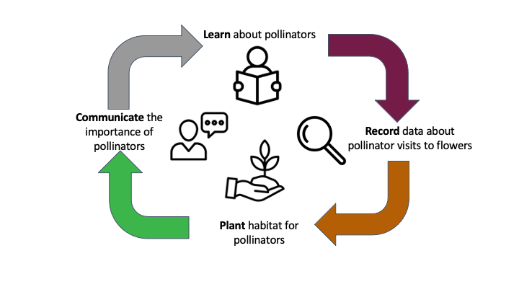
What’s Involved?

Slide 6
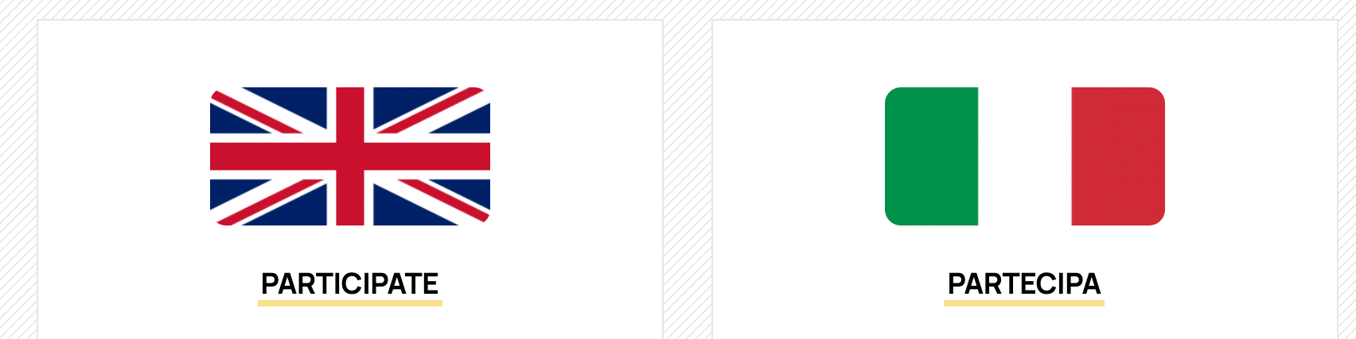
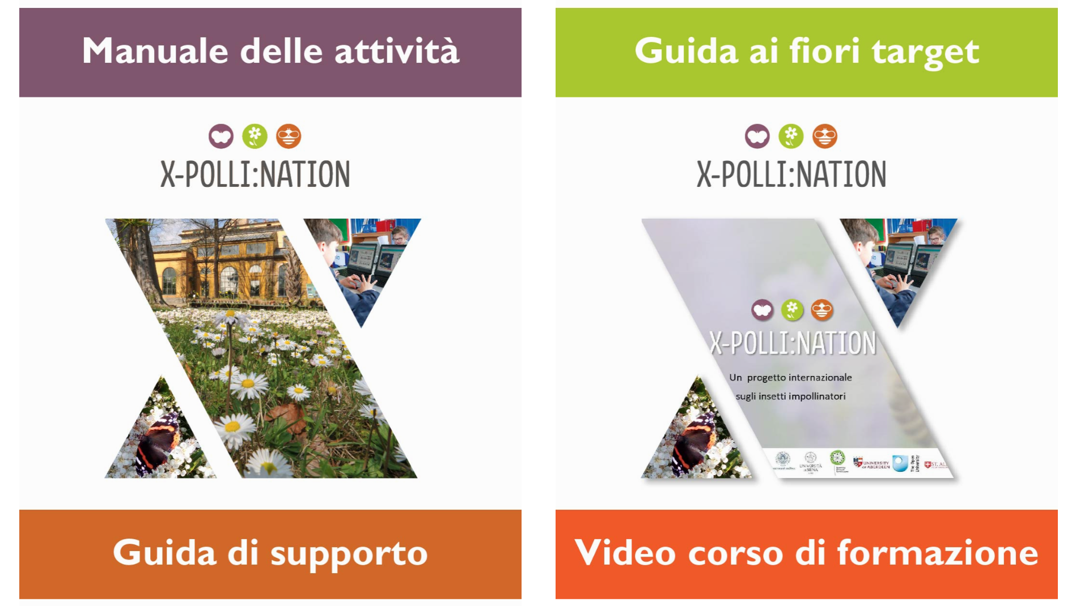
Who can take part?
Everyone!
The resources are specifically designed for school age pupils and their teachers but anyone is welcome to take part
The resources are in English and Italian

Slide 7
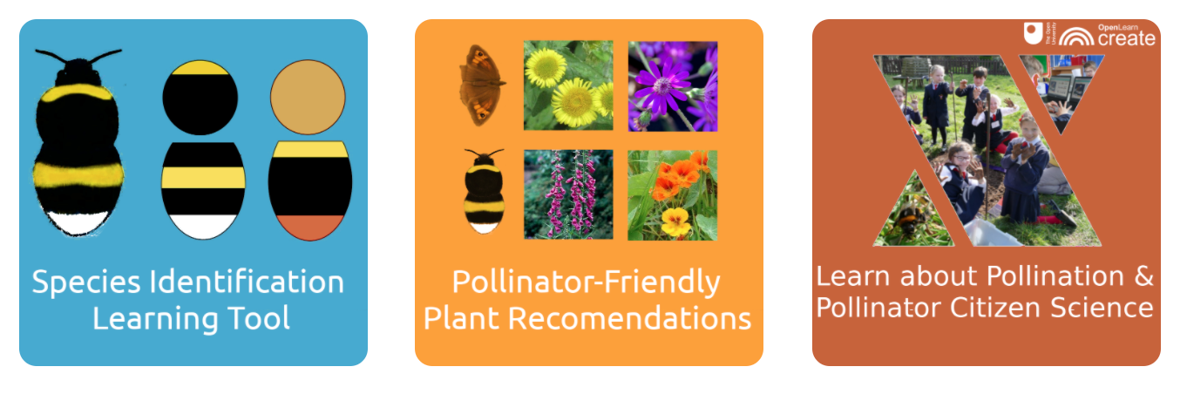
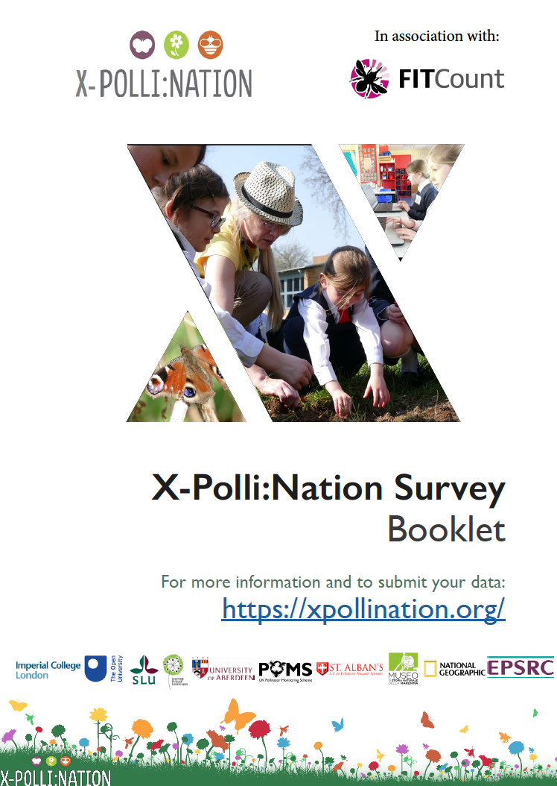
Resources for everyone
Online resources
Outdoor resources
Worksheets

Slide 8
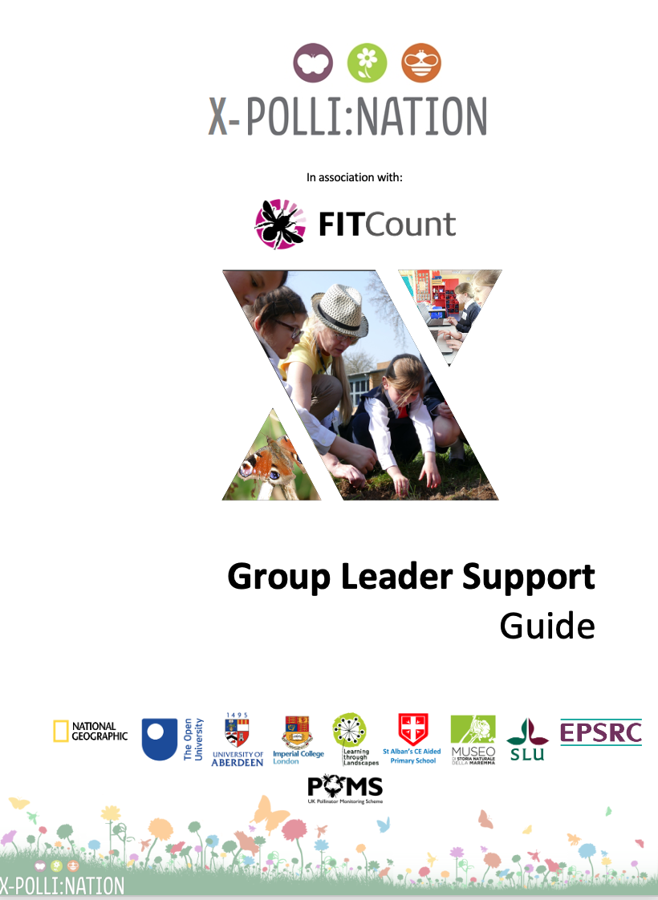
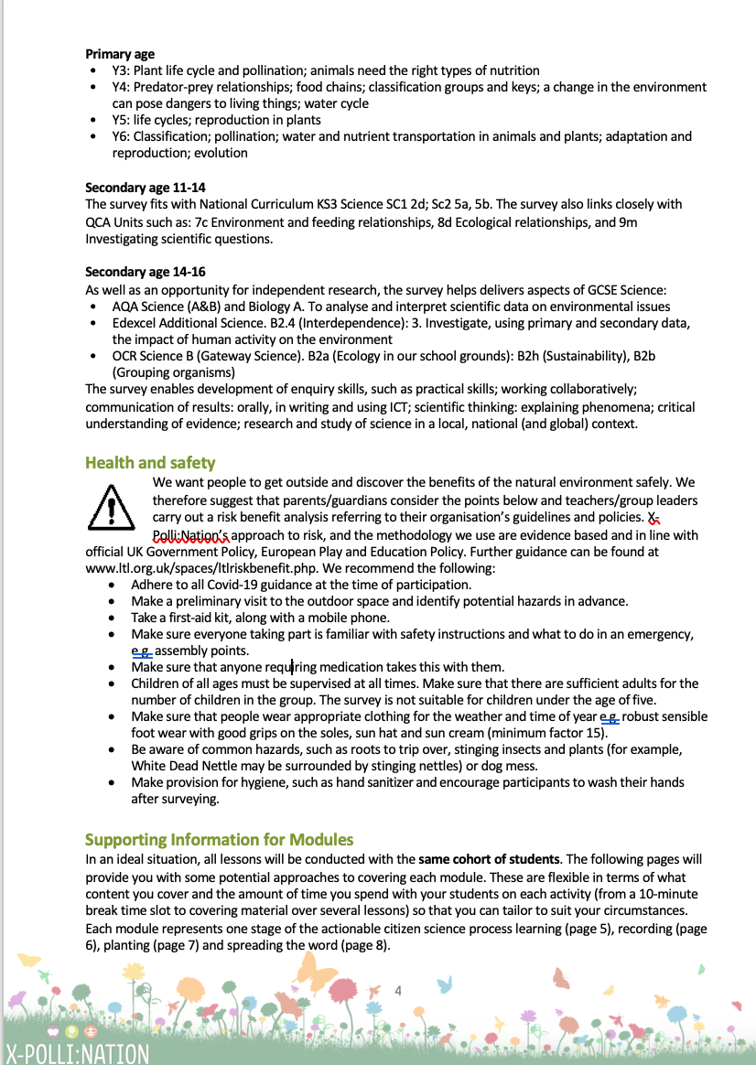
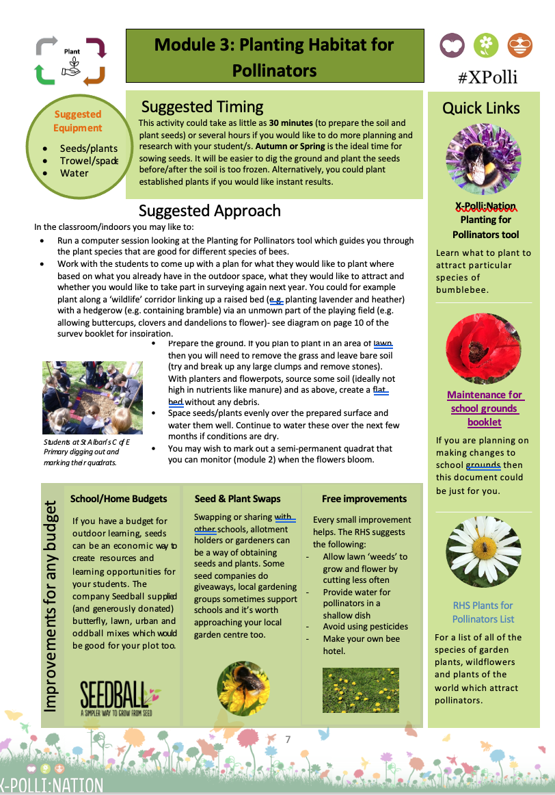
Resources for teachers, parents and group leaders
Curriculum links
Suggested approaches when working with a group
Learning objectives
Suggested equipment
Quick links to resources
Health & safety

Slide 9

Six-spot Burnet (Zygaena filipendulae)

Slide 10
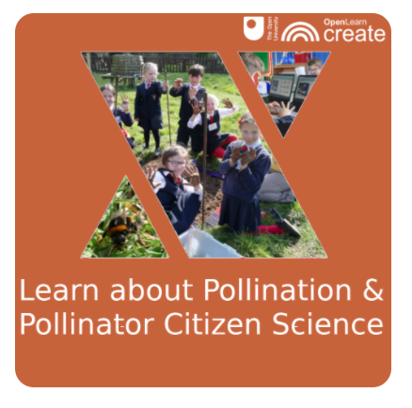
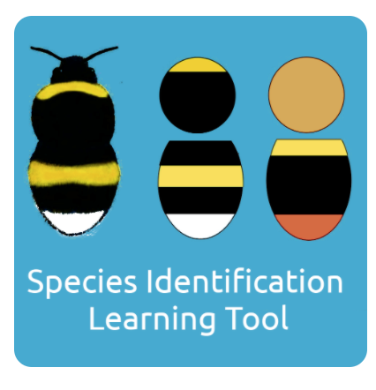
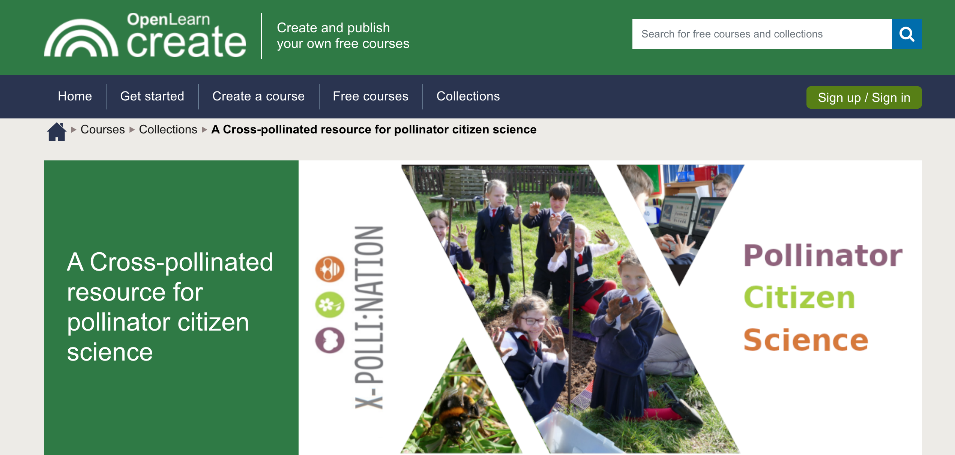
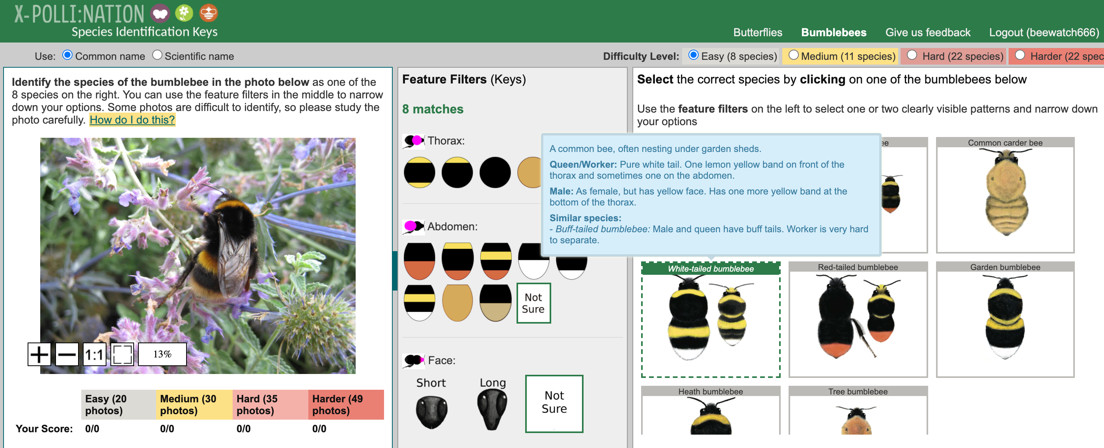
The Pack
Learning about pollinators
You can discover more about the diversity and importance of pollinators with our tools and resources.
Our online course will support you to find out what pollinators are, why they are important and why they are under threat.
Use our interactive training tool to explore patterns on bumblebees and butterflies and help you identify species.

Slide 11
Why do we need pollinators?
Grocery shelves without bees
.
Notes:
Flowering plants need pollinators: In temperate zones 78% flowering plants require animal pollination
100 crops provide 90% of the worlds food
We depend upon insects to pollinate our crops: The loss of pollinators could cost the Europe around €15 billion in lost crops alone
We need more than just bees: Different plants need different pollinators. A Honeybee tongue is only 7.0mm. Any plants with longer or shorter nectar spurs than this require different pollinators
Image from https://www.fastcompany.com/1672866/this-is-what-our-grocery-shelves-would-look-like-without-bees

Slide 12
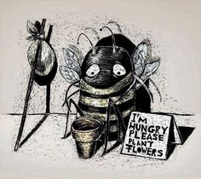
What are the threats to pollinators?
Habitat loss
Pests and diseases
Climate change
Pesticide use
Invasive species
Notes:
Our Pollinators have two big problems…
They are HUNGRY And They are HOMELESS
They need food, homes and shelter.
Their needs change depending on the stage of their life
Why?
Habitat loss
Pests and diseases
Climate change
Pesticide use
Invasive species

Slide 13
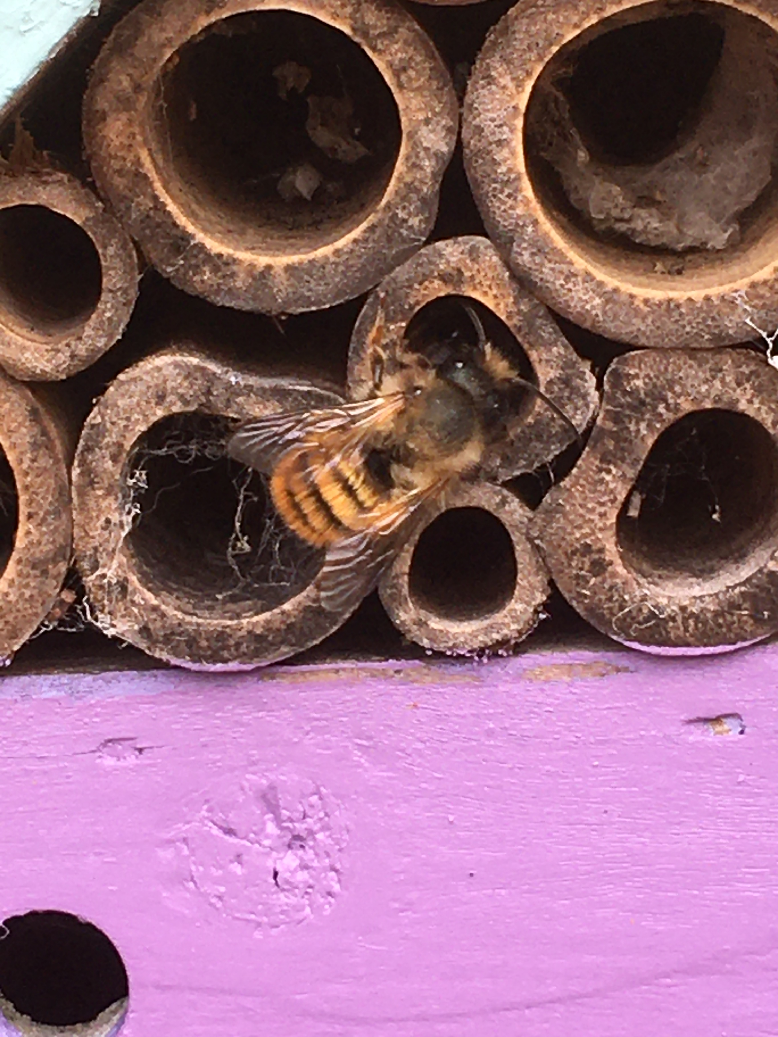
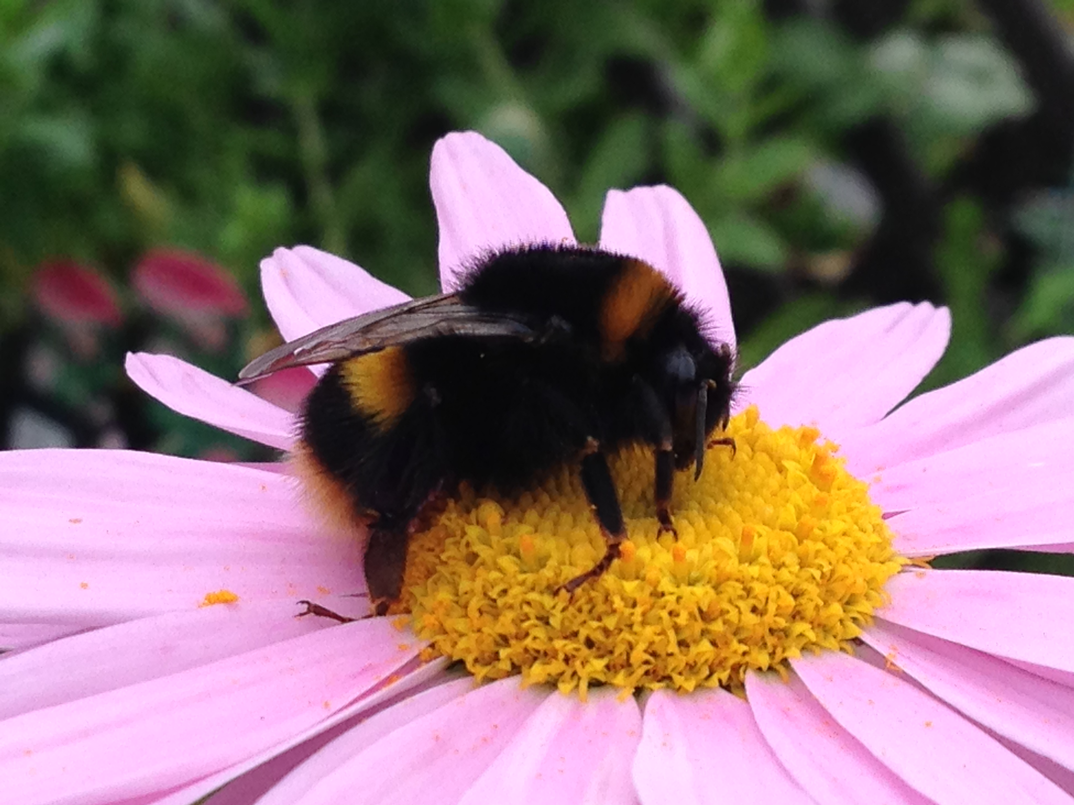
What do pollinators need?
Food
Shelter
Notes:
Pollinators need resources to provide them with food and shelter
This can change depending on the stage of their lifecycle….
For example, the red admiral needs nettles while they are a caterpillar and scabious as an imago (adult).
The honeybee needs somewhere to nest – for example the hive here and solitary bees such as the ashy mining bee excavated small tunnels in the earth to make their nests. Others use old rodent holes to nest in.

Slide 14

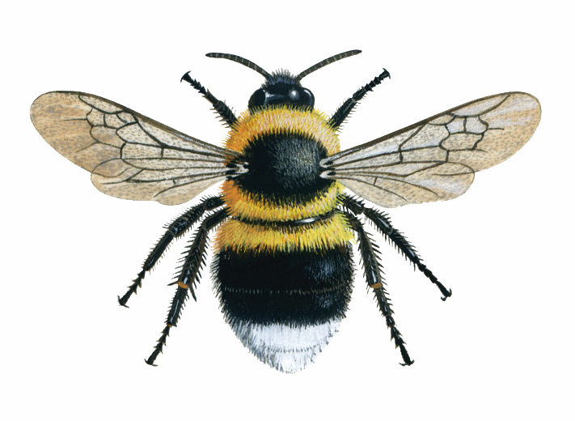
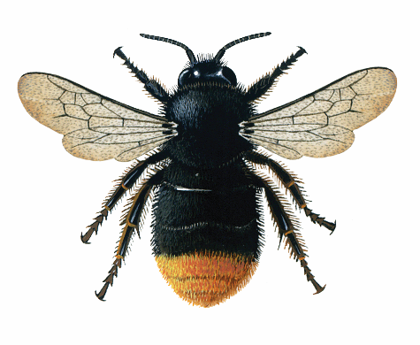
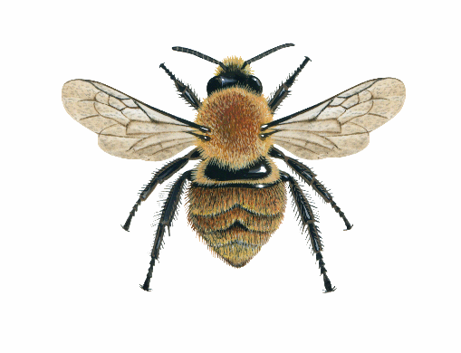
Pollinator Groups: Bumblebees
Long antennae
Two pairs of transparent wings
Round furry body 8-30mm
There are 25 species of bumblebee in the UK
Species Examples
Red-tailed Bumblebee
(Bombus lapidarius)
Common Carder Bumblebee
(Bombus pascuorum)
Red-tailed:
Black glossy fur
Conspicuous red tail
Common Carder:
Ginger
Dark abdomen
Notes:
Bumblebees: 25 spp (after reintroduction of short haired bumblebee. Lok out for round furry bodies (distinct from other bees which tend to be smaller and more slender), long antennae (flies have short) and two pairs of wings (flied have one). Quest species: Re-tailed- black glossy ‘fur’ and red tail as name suggests; Common carder- ginger with a dark abdomen.

Slide 15
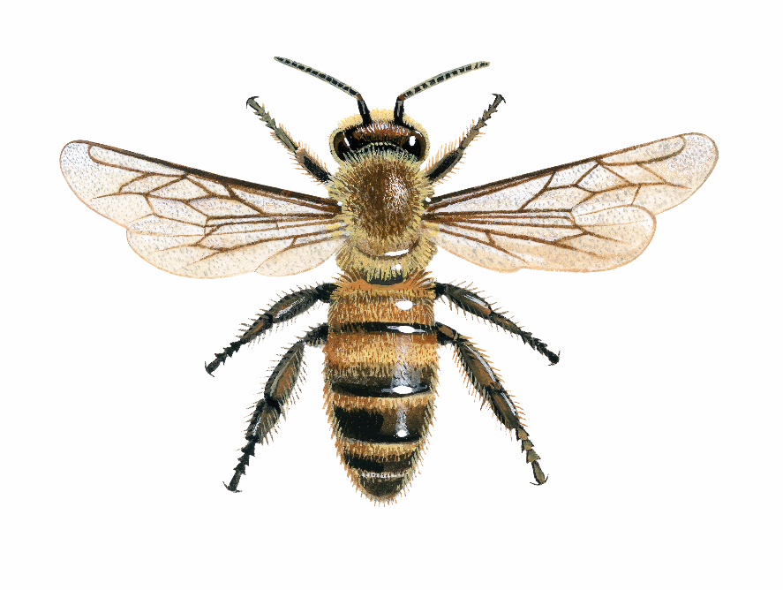
Pollinator Groups: Honeybees
Long antennae
Two pairs of see-through wings
Striped ginger brown body,
5-15mm
Honeybee
(Apis mellifera)
Honeybees:
Of the 270 different bee species in Britain (98 in Ireland), only one species is infamous; the Honeybee.
Too many Honeybee colonies in an area will have a negative impact on other wild pollinators as they will take more than their share of nectar and pollen.
There can be several thousand Honeybees in a colony, whereas a Bumblebee may have around 100 bees in a colony at the peak of the season.
Notes:
16- Honeybee- One species- rock star of pollinators (one we hear about in the media). More slender than bumblebees. Striped ginger brown body. Facts about bees- Colonies can have several thousand individuals. Must remember that other pollinators needed as they have different length tongues to visit bees and so too many in an area can be detrimental.
.

Slide 16
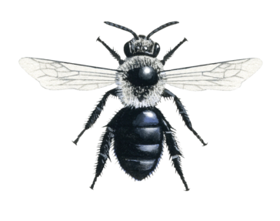
Pollinator Groups: Solitary Bees
Long antennae
Two pairs of see-through wings
Narrower body than bumblebee, 3-15mm
Ashy Mining-bee
(Andrena cineraria)
Solitary bees: There are more than 250 species of solitary bee in Britain. They are so named because, unlike honeybees and bumblebees, they do not live together in gregarious colonies (although you may find lots living together in an aggregation!).
The Ashy Mining-bee is only active in the spring and the only solitary bee to be so distinctively grey.
Notes:
Over 250 species according to BBCT. I like the link between 25 bumblebee species and 250 solitaries, as it makes it easy to remember. Live by themselves- often in excavated holes in bare earth banks or old rodent nests etc. Narrower body than bumblebee. Ashy mining- distinctively grey- active in the spring.

Slide 17
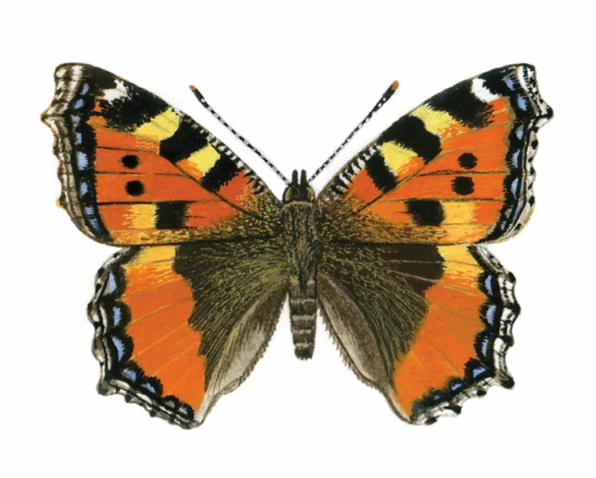
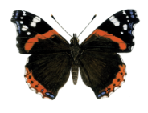
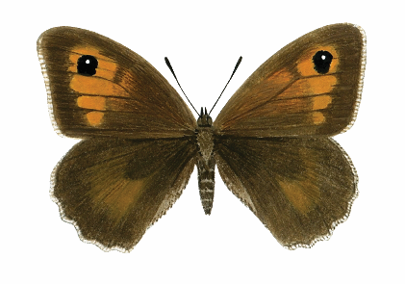
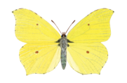
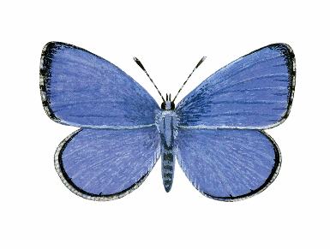
Pollinator Groups: Butterflies
Clubbed antennae
Butterflies GENERALLY rest with their wings closed vertically over their body BUT NOT ALWAYS, and certainly not on sunny days when they are basking
Species Examples
Red Admiral
(Vanessa atalanta)
Meadow Brown
(Maniola jurtina)
Brimstone
(Gonepteryx rhamni)
Holly Blue
(Celastrina argiolus)
Notes:
57 butterflies in the UK (BC)Generally brighter than moths, day flying, clubbed antennae and land with wings closed. Rd admiral distinctive red band- could get confused with Peacock; Meadow brown in grasslands, larger than gatekeeper or ringlet, Brimstone- yellow but females paler can get confused with large whites ; Holly blue- can get confused with other blues…why training tool comes in handy.

Slide 18
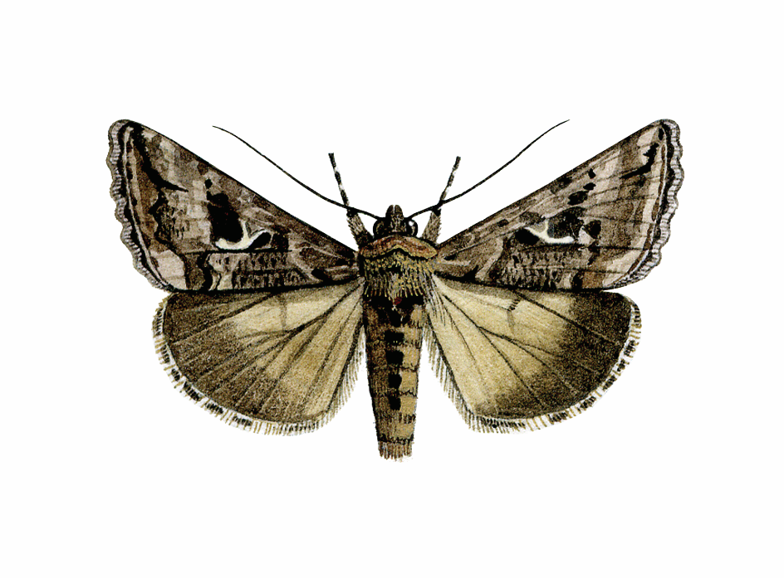
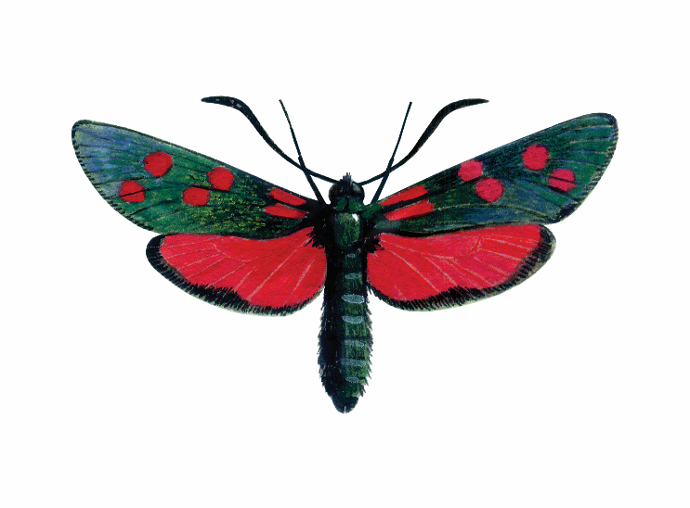
Pollinator Groups: Moths
Most species have feathered antennae
Some species rest with their wings open, BUT MANY DO NOT
  There are approximately 2,500 species of moth in the UK.
Many are important pollinators and potential food for other animals.
Species Example
Six-spot Burnet
(Zygaena filipendulae)
The Six-spot Burnet is associated with really good grassland habitat
There is a much rarer Narrow-bordered Five-spot version! … check the spots!
Notes:
2500 species in the UK; Generally night flying, duller looking, feathered antennae and land with wings open (however there are exceptions…Not all moths are nocturnal Not all are brown/grey/dull/look the same. Six spot burnet- indicator of good grassland habitat so would be great if you see this in future years. Be careful not to confuse with the narrow bordered five spot version.

Slide 19
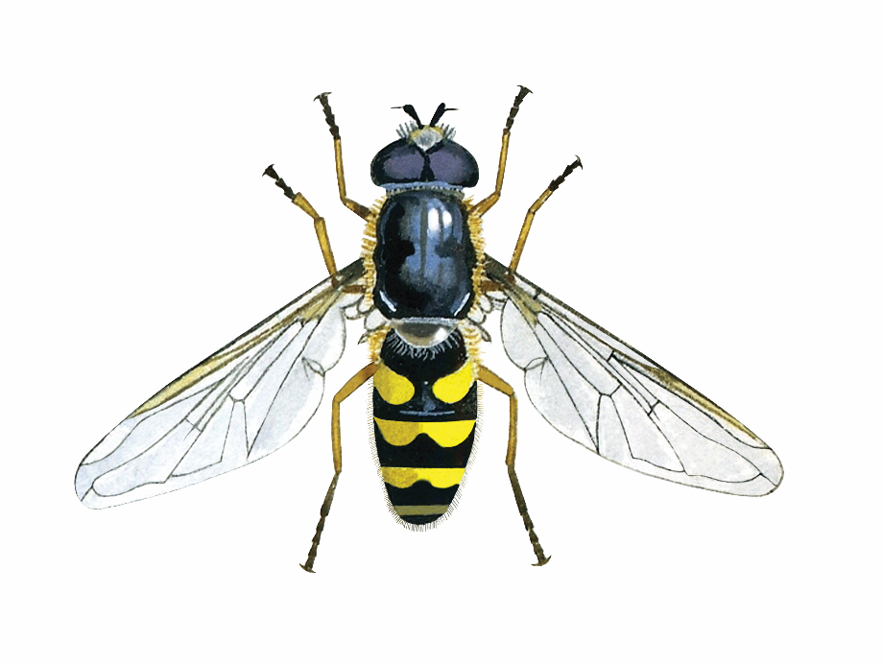
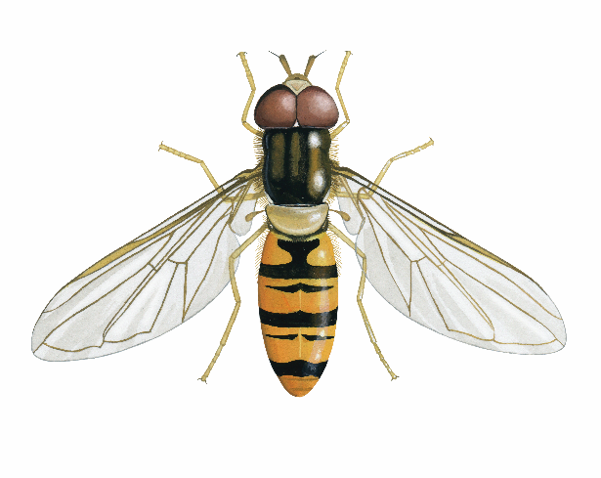
Pollinator Groups: Hoverflies
Short club-like antennae
Don’t confuse with wasps
Large eyes (look like sun-glasses)
Striped body
Hoverflies: There are over 200 species of hoverfly in the UK, with a wide range of appearances, often mimics of other species.
Adult hoverflies mainly feed on nectar and pollen, but the larvae of many species are predators of aphids and other garden pests. As a result, they act efficiently as both pollinators and pest controllers.
Species Example
Marmalade Hoverfly
(Episyrphus balteatus)
The Marmalade Hoverfly is a distinctive pink-orange colour with ‘moustache’ markings.
Notes:
Still part of the fly group but a very important pollinator and 200 spp in the UK. Hoverflies often get mistaken with wasps due to the black and yellow stripes (indeed they mimic them to look more dangerous to predators)- look for sunglasses and their flight motion (as the name suggests hovering- helicopters of the insect world!); Marmalade distinctive pink orange colour with moustache markings

Slide 20
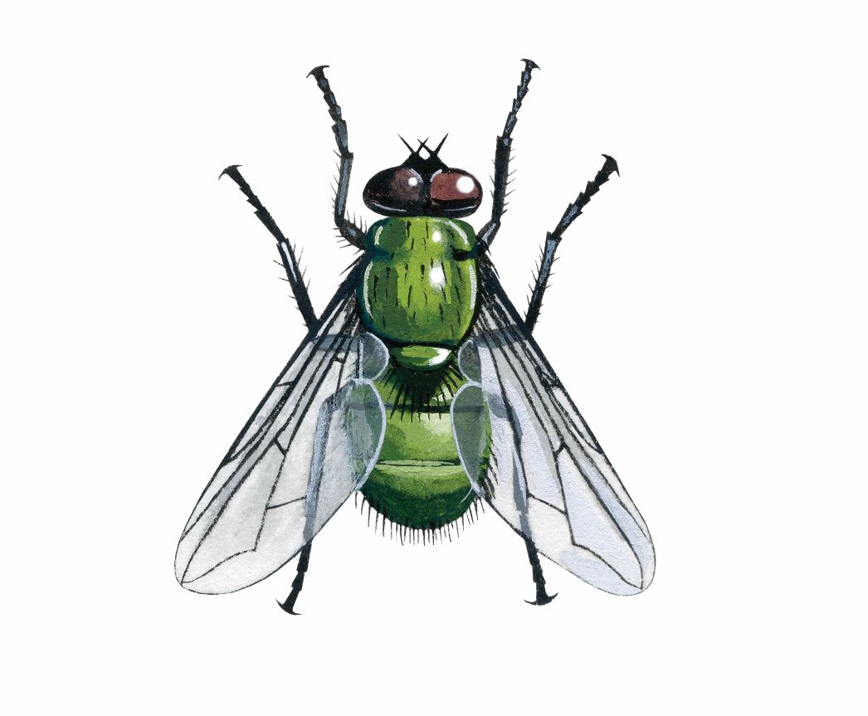
Pollinator Groups: Flies
Short antennae
Larger eyes
One pair of see-through wings
Flies
A really diverse group within the UK and our largest order with over 7000 species and new ones being discovered still.
All flies have eyes that practically meet in the centre of their head, making them look as if they are wearing sunglasses.
Notes:
Look for those eyes!- wrap around sunglasses; short antennae (compared to beed) and only one pair of wings. Very diverse- 7000 spp

Slide 21
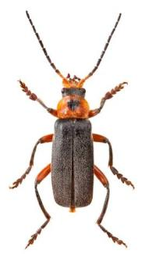
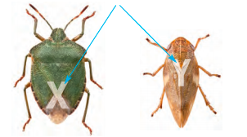
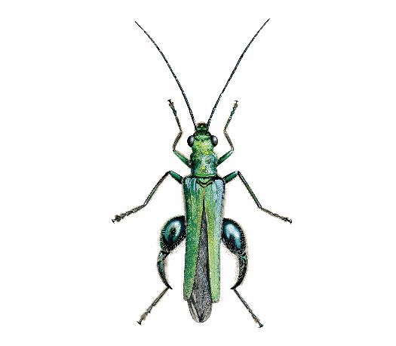
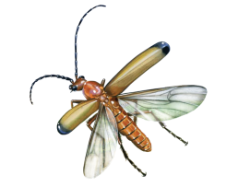
Pollinator Groups: Beetles
Don’t confuse with True Bugs
Biting mouthparts
Hard outer wing cases (elytra),
meeting in a ‘T’ shape
Species Examples
Beetles
Beetles are one of the largest orders of insects in the UK, with over 4,000 species including ladybirds.
Beetles are a very diverse group and contribute to the breakdown of organic matter in addition to being a potential predator and pollinator.
Thick-legged Flower Beetle
(Oedemera nobilis)
Red Soldier Beetle
(Rhagonycha fulva)
Notes:
Beetles have hard cases which meet in a Tshape (can get confused with true bugs which make an X shape). Veyy diverse group with 4000 species in the UK. Thick legged flower beetle looks like it is wearing pantaloons-iridescent green colour- common in gardens. Red soldier beetle known as the ‘bloodsucker’ from appearance but it is harmless. Eats aphids and other pests, often found crawling around the tops of flower heads making it a good pollinator- can often be seen in pairs mating.

Slide 22

Red Admiral (Inachis io)

Slide 23
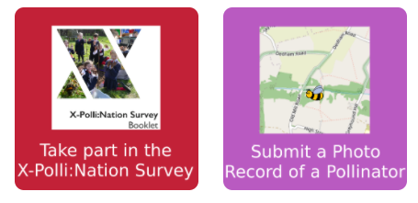
The Pack
Recording pollinators
Take part in citizen science and contribute valuable new data about vital insect populations and their habitats.
There are two steps:
Taking part in a Citizen Science Survey, counting the number of insects in different groups (e.g. bumblebee, beetle, butterfly etc.) landing on a target flower for 10 minutes
Taking a photo of a bumblebee and using Artificial Intelligence to help identify the species (e.g. garden, short tailed bumblebee etc.)

Slide 24
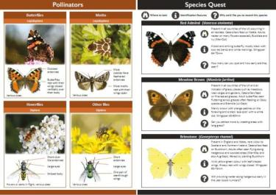
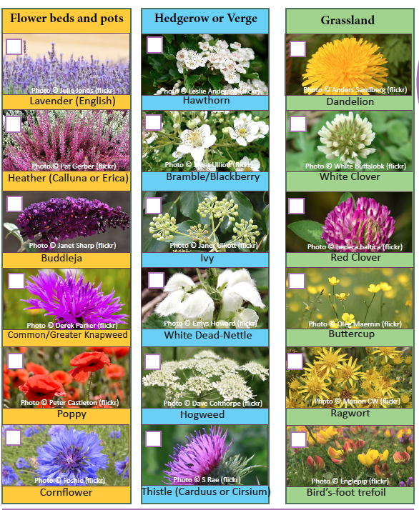
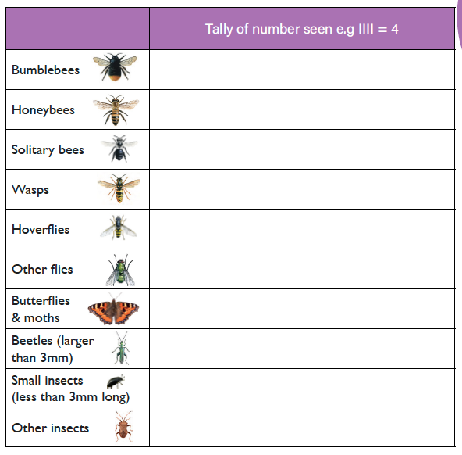
The Survey Booklet Contents
1. Citizen Science Survey
This Survey follows the Pollinator Monitoring Scheme (PoMS) methodology - which provides data for UK Biodiversity Indicators.
You will provide valuable data by following instructions in the Survey Booklet, and with the help of the Identification Guide, using the Recording Sheets to fill out information on the:
LOCATION
HABITAT
POLLINATORS
WEATHER

Slide 25
The Survey Booklet Contents
2. Photo record of species
While taking part in the survey or at any time, you can take photos of bumblebees and submit to our dedicated recording scheme Planting for Pollinators, where you will be guided by technology to help identify the species (e.g. Red Tailed or Buff-Tailed Bumblebee etc.)

Slide 26


Entering results online
Upload your Results
It is really important that you upload your results (even if you don’t find any insects. This will help our scientists at Imperial College London and the Centre for Ecology and Hydrology monitor changes pollinator populations over time.
https://xpollination.org

Slide 27

Plant
Students from St Alban’s School used upcycled containers for pollinator friendly plants
Buff tailed Bumblebee (Bombus terrestris)

Slide 28
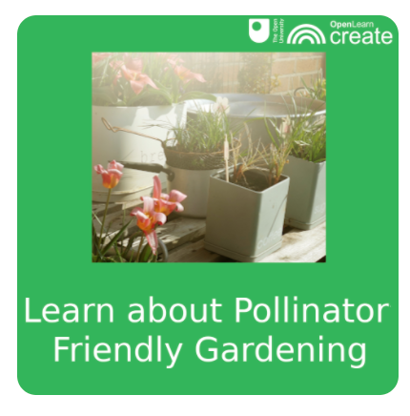
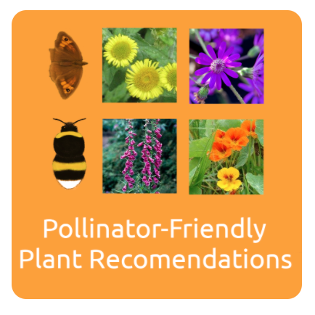
Entering results online
Planting for pollinators
Pollinators need homes and food to live. We benefit from healthy pollinator populations as they help produce the food we eat. You can help create suitable habitats for them in your local patch.
Our online course will support you to make simple changes to your patch, plan your garden and maintain it
Did you know that different bumblebees feed on different flowers? Use our interactive tool to help you select what species you want to attract into your patch.

Slide 29

Communicate
Students from St Alban’s School being awarded a Defra Bees Needs certificate for their Pollinator Promise campaign
Buff tailed Bumblebee (Bombus terrestris)

Slide 30

Communicating the importance of pollinators
Entering results online
Inspiring your friends, family and others in your community to protecting pollinators can make a real difference.
There are two parts to the Communicate activities:
1. Making a Pollinator Promise: When you sign up to the Pollinator Promise, you pledge to plant a pot or put aside a 1 x 1 metre area in your garden, school grounds or business to grow pollinator-friendly plants.
2. Designing your own Campaign for Pollinators: We also encourage you to come up with your own creative ideas about how you can spread the message to protect pollinators and share these on our social media account (@XpolliProject #xpolli #pollipromise)

Slide 31

Thank you for taking part!
https://xpollination.org
@XpolliProject #xpolli

